Slide 1
PHoEnix Association presents VERILOG WORKSHOP
Day 1
Overview of Digital design and circuits

Slide 2
Some identities of Boolean Algebra
x+0=x
x+x’=1
x+y=y+x
x.1=x
x.x’=0
x+x=x
(x’)’=x
x+xy=x
x.x=x
x(x+y)=x
De-Morgan’s Law:
(x+y)’=x’.y’
(x.y)’=x’+y’

Slide 3
Algebraic Simplification of Boolean Functions
A | B | C | F
0 | 0 | 0 | 0
0 | 0 | 1 | 0
0 | 1 | 0 | 1
0 | 1 | 1 | 0
1 | 0 | 0 | 1
1 | 0 | 1 | 1
1 | 1 | 0 | 1
1 | 1 | 1 | 1
Represented as SOP
Each of these is called a minterm
F= A’BC’ + AB’C’ + AB’C + ABC’ + ABC
F= A’BC’ + AB’(C’ + C) + AB(C’ + C)
F= A’BC’ + A(B’ + B)
F= A’BC’ + A
F= A’BC’ + A + ABC’ since x+xy=x
F= (A’ + A)BC’ + A
F=A+ BC’
F
SOP= Sum of Products

Slide 4




K-Maps: A better way of simplification
A | B | C | F
0 | 0 | 0 | 0
0 | 0 | 1 | 0
0 | 1 | 0 | 1
0 | 1 | 1 | 0
1 | 0 | 0 | 1
1 | 0 | 1 | 1
1 | 1 | 0 | 1
1 | 1 | 1 | 1
BC
00 01 11 10
A
0
1
1
1
1
1
1
F= A + BC’
Some points about K-maps:
A K-map made up of squares, each square represents a minterm /maxterm
Number of squares depend on number of input combinations
Only one bit variation between adjacent squares

Slide 5
Design of Digital circuits
There are 2 types of circuits: Combinational and sequential
Combinational circuits: A Combinational logic circuit consists of a set of logic gates whose outputs at any time are determined from only the present combination of inputs
Sequential Circuits: A sequential logic circuit consists of a set of logic gates whose outputs at any time are determined from the present combination of inputs as well as previous output

Slide 6
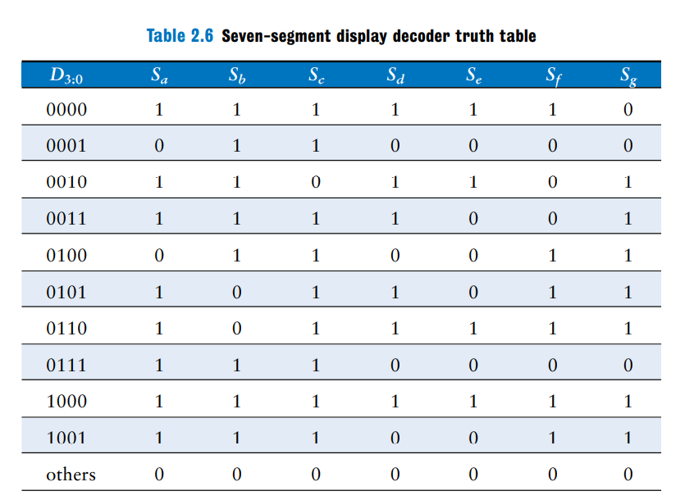
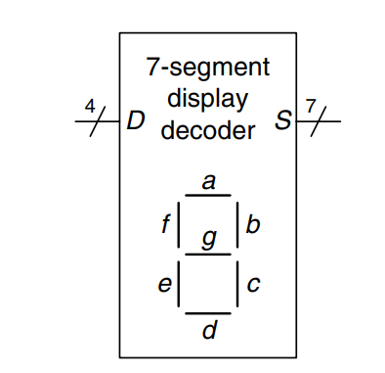
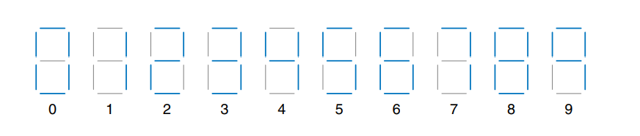
7-Segment Display Coder

Slide 7
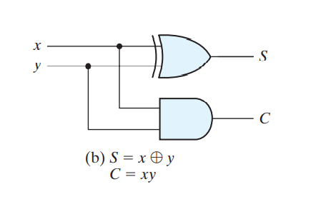
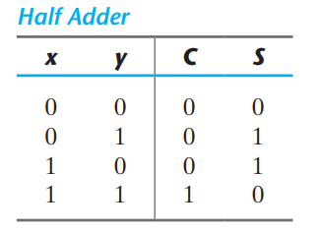

Half Adder

Slide 8
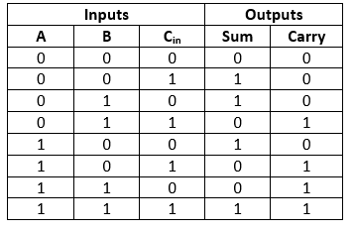
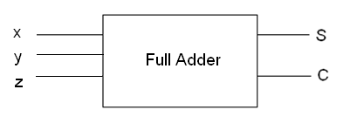




Full Adder
B Cin
00 01 11 10
A
0
1
For S
1
1
1
1
Chessboard configuration => XOR function
B Cin
00 01 11 10
A
0
1
For Cout
1
1
1
1
S = A + B + Cin
Co= AB + Ci(A + B)

Slide 9
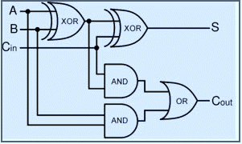
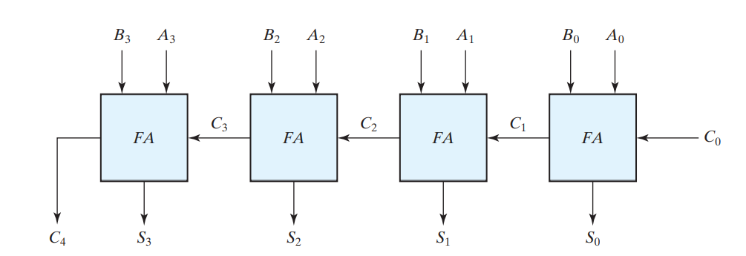
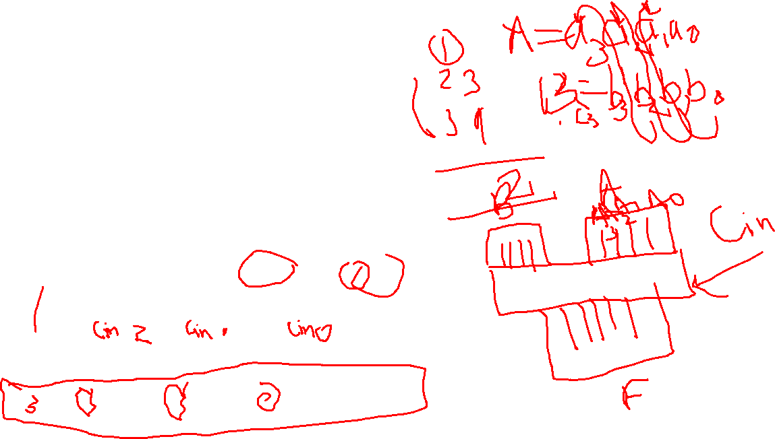

Slide 10
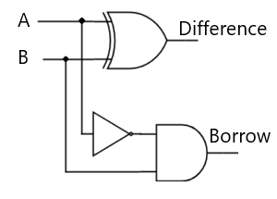
Half Subtractor
x y
D B
Half Subtractor
A | B
0 | 0
0 | 1
1 | 0
1 | 1
D | Bo
0 | 0
1 | 1
1 | 0
0 | 0
D= A + B
Bo= A’B

Slide 11
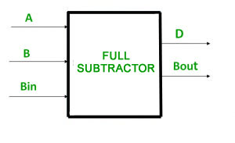
Full Subtractor

Slide 12
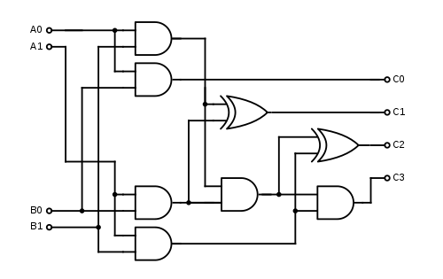
2-Bit Multiplier
B₁ B₀
A₁ A₀
B₁A₀ B₀A₀ B₀A₁
C₃ C₂ C₁ C₀
X
B1A1

Slide 13
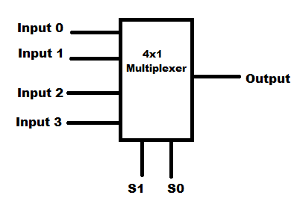
Multiplexers
It is a combinational circuit that selects binary information from one of the many input lines and directs it to the output line.
m=log n
2
I₀
0
O/P
I₁
1
No. of i/p lines
No. of select lines
S

Slide 14
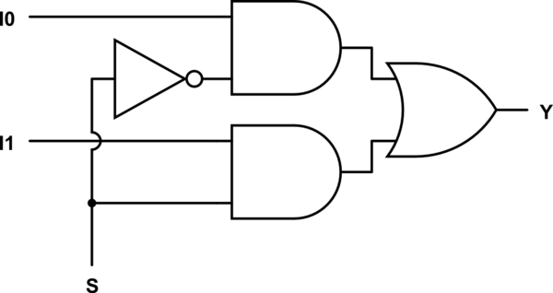
2:1 MUX
I₀
0
O/P
S | I₀ | I₁ | O/p
0 | 0 | 0 | 0
0 | 0 | 1 | 0
0 | 1 | 0 | 1
0 | 1 | 1 | 1
1 | 0 | 0 | 0
1 | 0 | 1 | 1
1 | 1 | 0 | 0
1 | 1 | 1 | 1
I₁
1
S | O/P
0 | I₀
1 | I₁
S
Simplified truth table
o/p = I₀.S’ + I₁. S

Slide 15
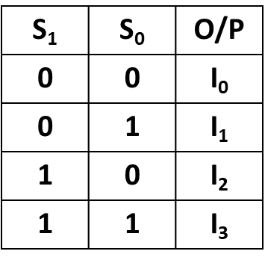
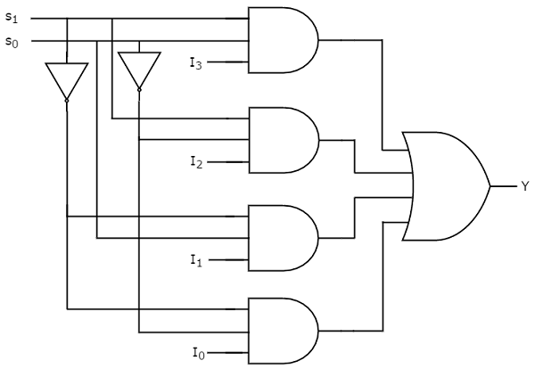
4:1 MUX
O/P = S₁’S₀’I₀ + S₁’S₀I₁ + S₁S₀’I₂ + S₁S₀I₃
I₀
0
I
1
1
O/P
I₂
2
I₃
3
S₀
S₁

Slide 16
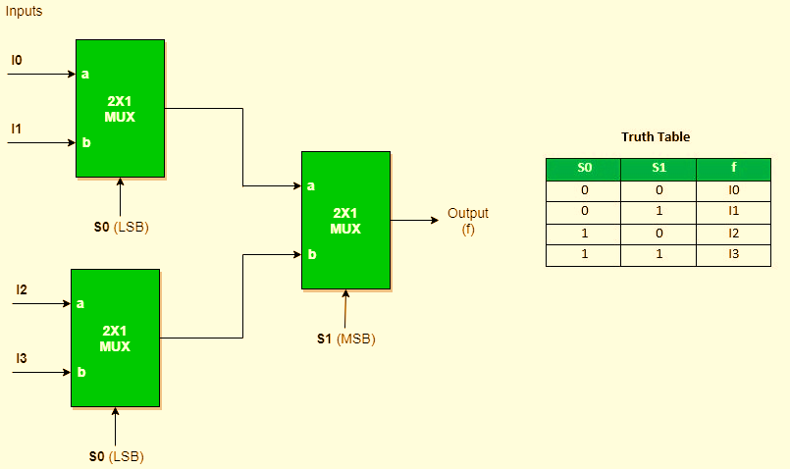



MUX Tree
3 2:1 MUX required to implement a 4:1 MUX
4/2 = 2 2/2 =1
2+1= 3 2x1 MUX required
S1
S0

Slide 17
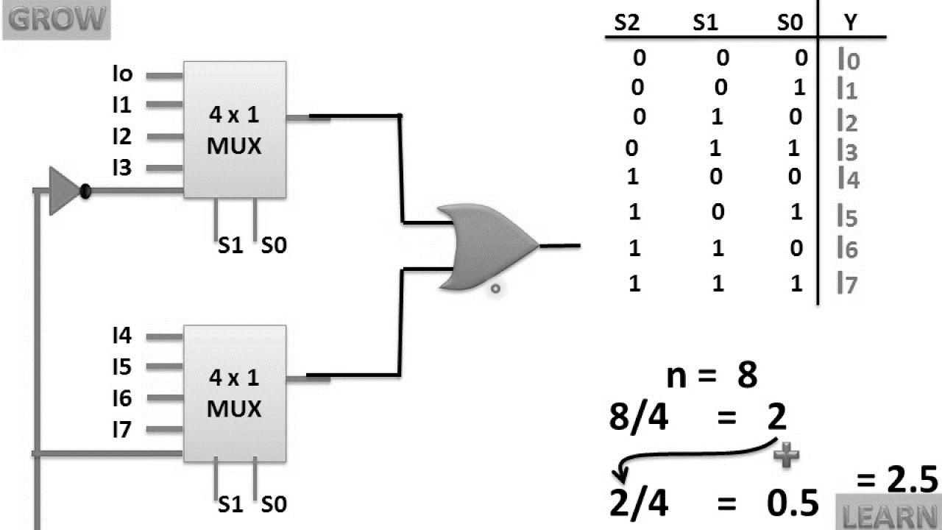




8X1 MUX using 4X1 MUX
$$8/4={2 2}/4=\frac{1}{2}$$
=> 2.5 4X1 MUX required
E
E

Slide 18

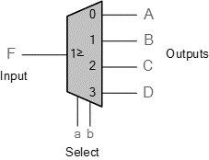
Demultiplexers
m=log n
2
One input, multiple outputs
Reverse operation of MUX
Called data distributor
No. of o/p lines

Slide 19
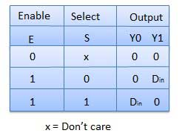
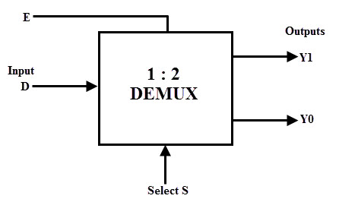
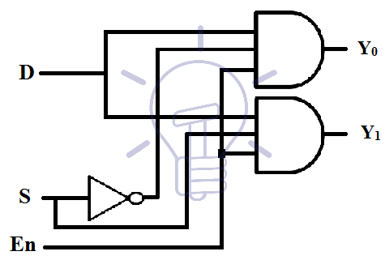
1:2 Demux

Slide 20
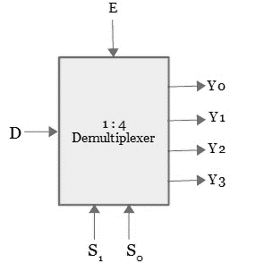
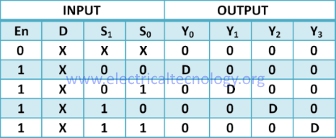
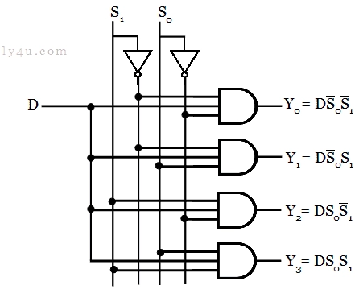
1:4 Demux

Slide 21
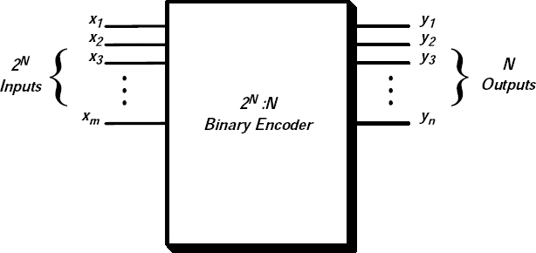
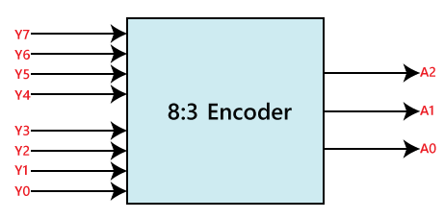
Encoders

Slide 22
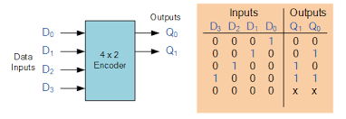
Encoders

Slide 23
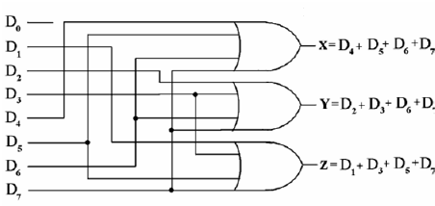
Encoders

Slide 24
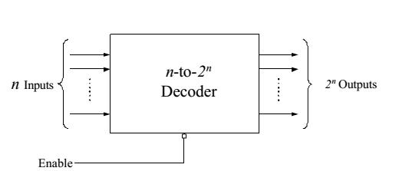
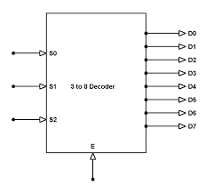
Decoders

Slide 25
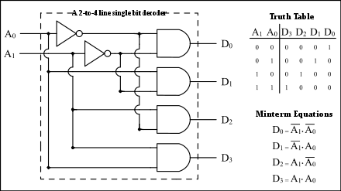
Decoders

Slide 26
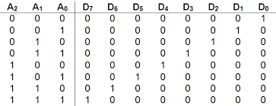
Decoders

Slide 27
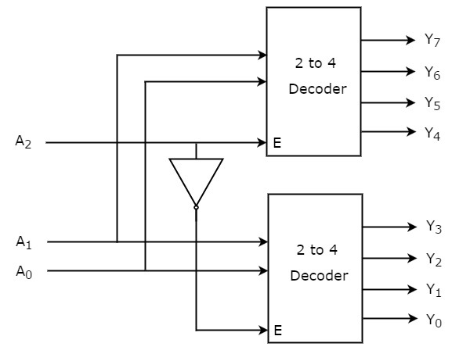
Decoders

